Slide 1

Paper ID: 1869
“Deep Neural Networks for Disease Classification from Endoscopic Imaging”
Authors Details:
Shatrudhan Chaudhary, Pragyan Dhungana, Rupak Aryal, Mithu Roy,
Mahesh T R, Ranjan Kumar Rajbanshi
Affiliation: Jain (Deemed-to-be University)

Slide 2
CONTENTS
Abstract
Introduction
Literature Survey
Problem Definition
Proposed Work
Methodology & Implementation
Results & Discussions
Conclusion
References

Slide 3
ABSTRACT
Objective: Enhance diagnostic accuracy of GI diseases using deep learning.
Key Outcomes:
U-Net architecture with 98.80% accuracy on KVASIR dataset.
Clinical relevance: Reduced human error, faster workflows.
Impact: Reliable and robust computer-aided diagnosis for GI diseases.

Slide 4
INTRODUCTION
Problem:
GI diseases are life-threatening if undiagnosed early.
Traditional endoscopy is prone to errors and relies on clinician expertise.
Solution:
Use CNNs for automated and accurate disease detection.
Employ U-Net architecture for superior segmentation.

Slide 5
LITERATURE REVIEW
Current Advances:
CNNs like ResNet101 achieve high performance but lack interpretability.
Public datasets such as KVASIR enable benchmarking for GI diagnosis.
Challenges:
Image quality variability.
Need for robust models with generalized accuracy.

Slide 6
METHODOLOGY
Model Overview:
U-Net Architecture: Encoder-decoder with skip connections for image segmentation.
Key Features:
Dataset: KVASIR, with data augmentation for robustness.
Training: Binary cross-entropy loss, Adam optimizer (learning rate: 0.001).
Evaluation Metrics: Accuracy, F1-score, AUC-ROC.

Slide 7
RESULTS
Performance:
Accuracy: 98.80% (better than ResNet101).
Validation Loss: 0.0309 (minimal overfitting).
Visuals:
ROC Curve: AUC = 0.97.
Confusion Matrix: Low misclassification rates.
Grad-CAM: Highlights model focus on abnormalities.

Slide 8
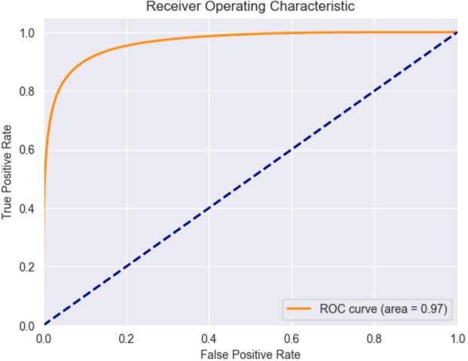
RESULTS
Receiver Operating Characteristic (ROC) Curve:
Shows the model’s ability to distinguish between abnormal and normal regions. AUC = 0.97: Indicates high sensitivity and specificity. Demonstrates robust classification performance critical for medical diagnostics.

Slide 9
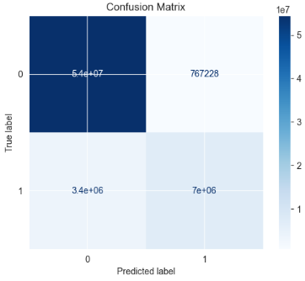
RESULTS
Confusion Matrix:
True Positives: Abnormal regions correctly identified. True Negatives: Normal regions correctly identified. Minimal False Positives and False Negatives highlight high diagnostic reliability.

Slide 10
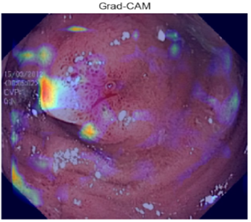
RESULTS
Grad-CAM Visualization:
Heatmaps show regions the model focuses on during predictions.
Highlights abnormalities/lesions, validating decision-making.
Builds interpretability and trust in clinical diagnostics.

Slide 11
DISCUSSION
Clinical Benefits:
Faster, more accurate diagnostics.
Reduces reliance on human expertise.
Challenges:
Slight overfitting; requires regularization.
Limited dataset diversity.
Future Work:
Explore Attention U-Net, hybrid CNN models.
Test in real-world clinical settings.

Slide 12
CONCLUSION
Achievements:
Developed a reliable U-Net-based model for GI diagnosis.
Demonstrated high accuracy, robustness, and clinical relevance.
Future Directions:
Address overfitting.
Validate in live clinical scenarios.

Slide 13
REFERENCES
Sheliakina, N. M., & Mashevsky, G. A. (2021). Using Deep Learning Techniques for Endoscopic Image Analysis. IEEE.
Cao, C., Liu, F., Tan, H., Song, D., Shu, W., Li, W., Zhou, Y., Bo, X., & Xie, Z. (2018). Deep Learning and Its Applications in Biomedicine. Genomics, Proteomics & Bioinformatics, 16(1), 17-32.
Koulaouzidis, A., Iakovidis, D. K., Yung, D. E., Rondonotti, E., Kopylov, U., & Plevris, J. N. (2015). Kvasir: A Dataset for Capsule Endoscopy.
Cai, W., Qin, J., Zheng, H., & Heng, P. A. (2017). A Survey on Deep Learning in Medical Image Analysis. Medical Image Analysis, 42, 60-88.
Ohmori, K., & Sakai, Y. (2019). Automated Detection of Esophageal Lesions in Endoscopic Images Using Deep Learning. Digestive Endoscopy, 31(2), 93-100.

Slide 14
THANK YOU

